Slide 1
Cornerstone City Church Peninsula Plus Community Hoo Are Ya
9th March 2025

Slide 2


Slide 3
Lead Me To The Cross
CCLI Song # 4785828
Brooke Ligertwood
© 2006 Hillsong Music Publishing Australia (Admin. by Hillsong Music Publishing UK)
For use solely with the SongSelect® Terms of Use. All rights reserved. www.ccli.com
CCLI Licence No. 33265

Slide 4
1/8
Saviour I come quiet my soul
Remember
Redemption's hill
Where Your blood was spilled
For my ransom

Slide 5
2/8
Ev’rything I once held dear
I count it all as loss

Slide 6
3/8
Lead me to the cross
Where Your love poured out
Bring me to my knees
Lord I lay me down
Rid me of myself
I belong to You
Oh lead me lead me to the cross

Slide 7
4/8
You were as I tempted and tried
Human
The word became flesh
Bore my sin in death
Now You're risen

Slide 8
5/8
Ev’rything I once held dear
I count it all as loss

Slide 9
6/8
Lead me to the cross
Where Your love poured out
Bring me to my knees
Lord I lay me down
Rid me of myself
I belong to You
Oh lead me lead me to the cross

Slide 10
7/8
To Your heart
To Your heart
Lead me to Your heart
Lead me to Your heart

Slide 11
8/8
Lead me to the cross
Where Your love poured out
Bring me to my knees
Lord I lay me down
Rid me of myself
I belong to You
Oh lead me lead me to the cross

Slide 13
Thanksgiving
CCLI Song # 7199589
Nick Herbert | Taku Mudere | Zo Chilengwe
© Capitol CMG Genesis; Safe and Sound Music; Remaining portion is unaffiliated
For use solely with the SongSelect® Terms of Use. All rights reserved. www.ccli.com
CCLI Licence No. 33265

Slide 14
1/8
Enter in (Enter in)
His courts with praise (His courts with praise)
For He is greatly (He is greatly)
To be praised (To be praised)

Slide 15
2/8
What shall we do
We shall lift up a shout
What shall we do
We shall praise Him
What shall we do
For our God made a way
We'll give Him our thanksgiving

Slide 16
3/8
Magnify (Magnify)
His Holy Name (His Holy Name)
For He is greatly (For He is greatly)
To be praised (To be praised)

Slide 17
4/8
What shall we do
We shall lift up a shout
What shall we do
We shall praise Him
What shall we do
For our God made a way
We'll give Him our thanksgiving

Slide 18
5/8
Even if the rocks cry out
We're gonna drown them out
With a louder shout of praise
Even when the battles roar
We're gonna praise You Lord
'Cause You are always worthy

Slide 19
6/8
You are worthy
Worthy of honour and praise
You are worthy
We'll sing it again and again

Slide 20
7/8
What shall we do
We shall lift up a shout
What shall we do
We shall praise Him
What shall we do
For our God made a way
We'll give Him our thanksgiving

Slide 21
8/8
We'll give Him our thanksgiving
We'll give Him our thanksgiving

Slide 22
Mighty to Save
CCLI Song # 4591782
Ben Fielding | Reuben Morgan
© 2006 Hillsong Music Publishing Australia (Admin. by Hillsong Music Publishing UK)
For use solely with the SongSelect® Terms of Use. All rights reserved. www.ccli.com
CCLI Licence No. 33265

Slide 23
1/6
Ev’ryone needs compassion
Love that's never failing
Let mercy fall on me
Ev’ryone needs forgiveness
The kindness of a Saviour
The hope of nations

Slide 24
2/6
Saviour He can move the mountains
My God is mighty to save
He is mighty to save
Forever Author of salvation
He rose and conquered the grave
Jesus conquered the grave

Slide 25
3/6
So take me as You find me
All my fears and failures
Fill my life again
I give my life to follow
Ev’rything I believe in
Now I surrender

Slide 26
4/6
Saviour He can move the mountains
My God is mighty to save
He is mighty to save
Forever Author of salvation
He rose and conquered the grave
Jesus conquered the grave

Slide 27
5/6
Shine your light and let the whole world see
We're singing
For the glory of the risen King
Jesus
Shine your light and let the whole world see
We're singing
For the glory of the risen King

Slide 28
6/6
Saviour He can move the mountains
My God is mighty to save
He is mighty to save
Forever Author of salvation
He rose and conquered the grave
Jesus conquered the grave

Slide 30
Hosanna CCLI Song # 4785835
Brooke Ligertwood
© 2006 Hillsong Music Publishing Australia
For use solely with the SongSelect® Terms of Use. All rights reserved. www.ccli.com
CCLI Licence No. 33265

Slide 31
1/8
I see the King of glory
Coming on the clouds with fire
The whole earth shakes
The whole earth shakes yeah

Slide 32
2/8
I see His love and mercy
Washing over all our sin
The people sing
The people sing

Slide 33
3/8
Hosanna hosanna
Hosanna in the highest
Hosanna hosanna
Hosanna in the highest

Slide 34
4/8
I see a generation
Rising up to take their place
With selfless faith
With selfless faith

Slide 35
5/8
I see a near revival
Stirring as we pray and seek
We're on our knees
We're on our knees

Slide 36
6/8
Hosanna hosanna
Hosanna in the highest
Hosanna hosanna
Hosanna in the highest

Slide 37
7/8
Heal my heart and make it clean
Open up my eyes to the things unseen
Show me how to love like You have loved me
Break my heart for what breaks Yours
Everything I am for Your Kingdom's cause
As I walk from earth into eternity

Slide 38
8/8
Hosanna hosanna
Hosanna in the highest
Hosanna hosanna
Hosanna in the highest

Slide 40


Slide 41


Slide 42
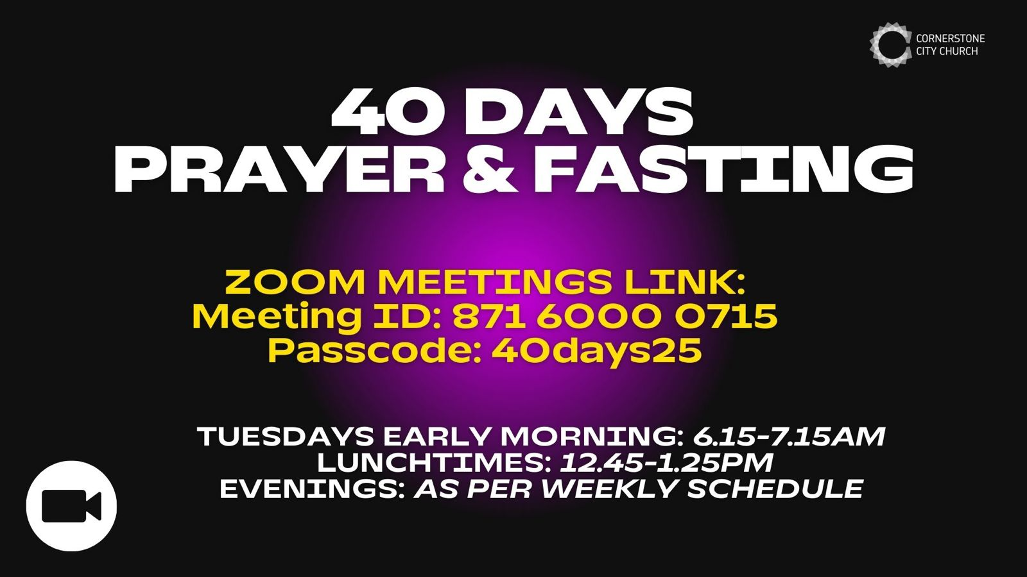

Slide 43


Slide 44


Slide 45


Slide 46
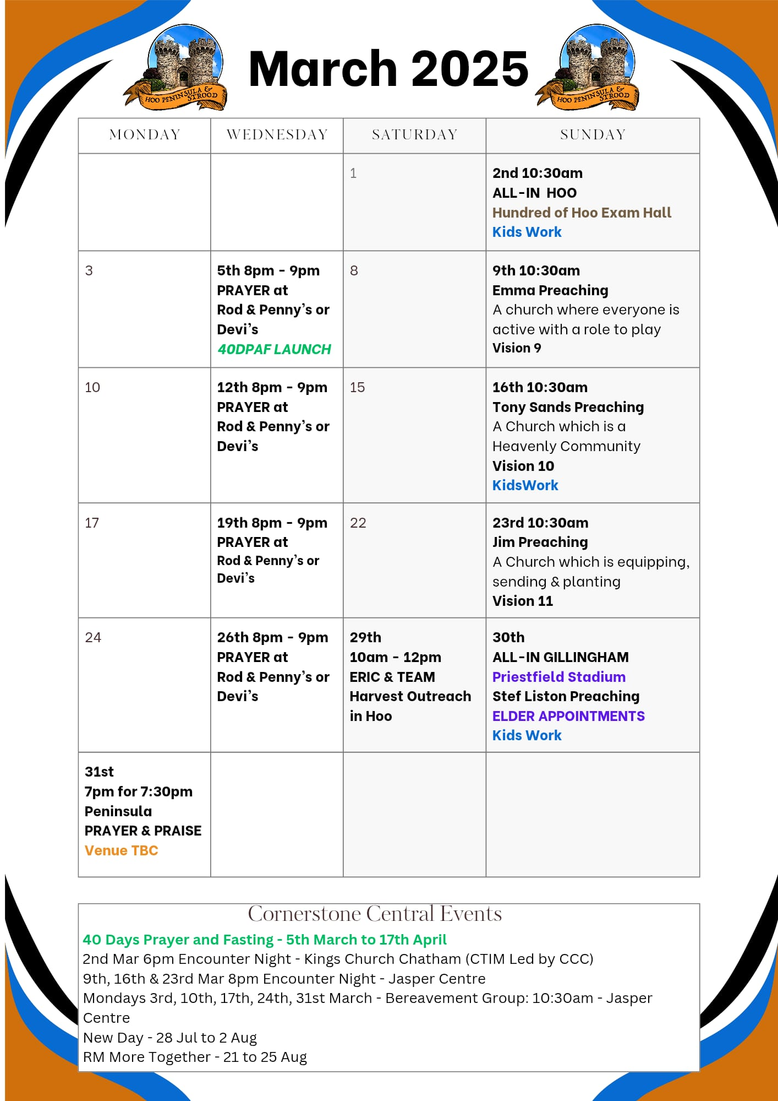

Slide 47

Grow Group 1
Grow Group 1 Name: On YOUR MARK!

Slide 48
Leaders
Leaderss
Phil & Kim
Maria (Mia) Warren
Matthew Harrison
Richard & Elisha Acheampong
Phil & Kim
Maria (Mia) Warren
Matthew Harrison
Richard & Elisa Acheampong

Slide 49
Q1 into Q2 Meeting Dates
Q1 into Q2 Meeting Dates
Month | Date / Day | Host
January | Saturday 11th | Maria
 | Wednesday 22nd | Maria
February | Saturday 8th | Venue Needed
 | Wednesday 19th | Phil & Kim
March | Saturday 8th | Richard & Elisha
 | Wednesday 19th | Venue Needed
April | Saturday 12th | Matt
 | Wednesday 30th | Venue Needed

Slide 50

Storm Walker
Storm Walker
Symbolising, trust in Jesus Christ through life's storms.
Mark 4:35-41

Slide 51



Group Leaders
Micheal and Mwamba
Wilfred and Parveen
Hannah

Slide 52
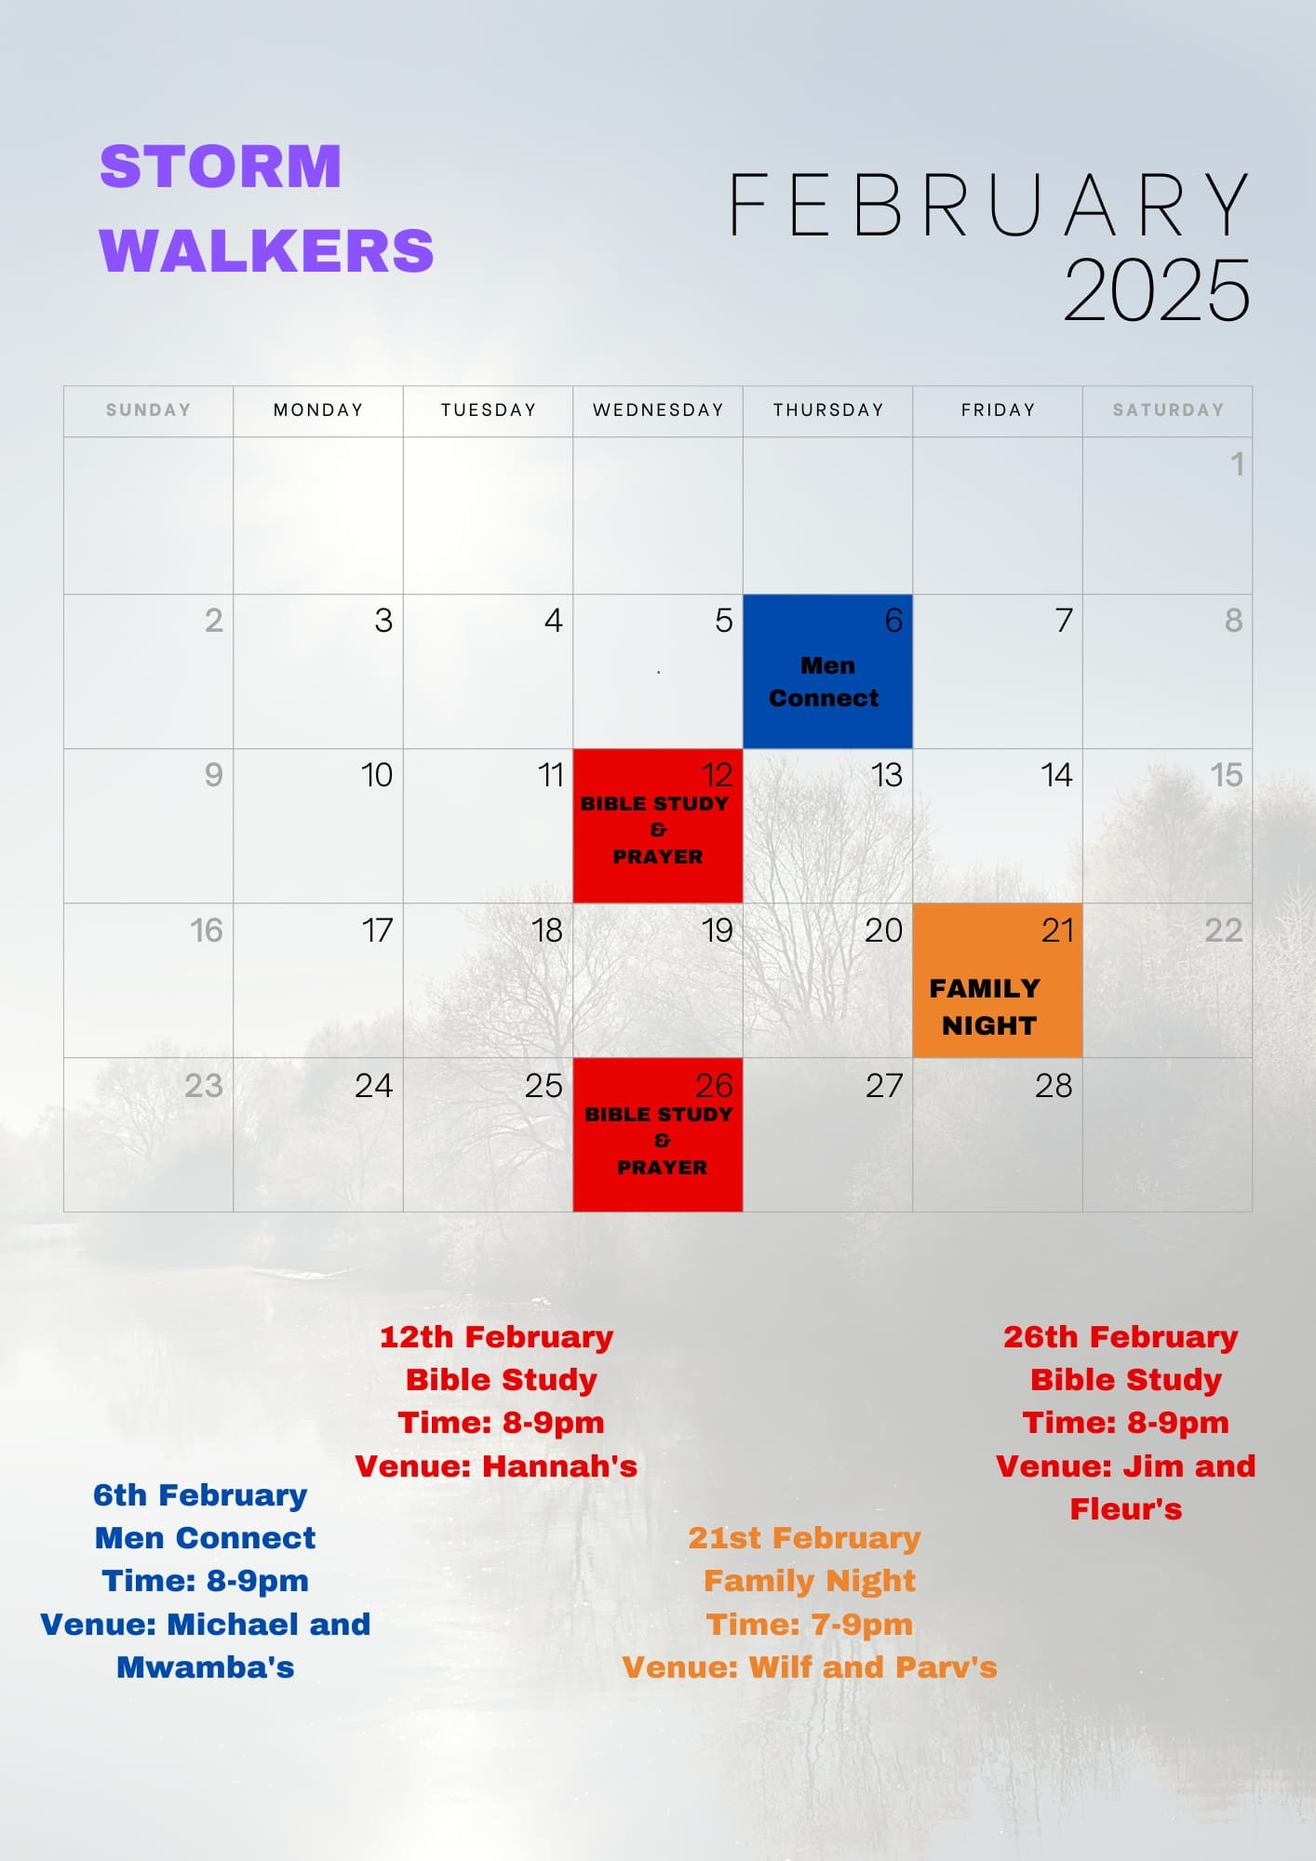

Slide 53


Slide 54
2 Corinthians 14 May the grace of the Lord Jesus Christ, and the love of God, and the fellowship of the Holy Spirit be with you all
Surely goodness and mercy shall follow me all the days of my life, and I shall dwell in the house of the Lord forever.

